Slide 1
TRANSPORT IN LIVING SYSTEMS
Aim: How is transport characterized?

Slide 2
I. TRANSPORT:
the life function that entails the movement of material from one location to another.
II. TYPES OF TRANSPORT
a. Passive Transport: the movement of material from a high to low concentration without the use of energy.
b. Active Transport: the movement of material from a low to high concentration with the use of energy.
NOTE: Concentration refers to the amount of a given material in a given area, space, or volume.
Concentration gradient refers to a comparison of solute concentration in one area as compared to another.

Slide 3
III. TYPES OF PASSIVE TRANSPORT
a. Diffusion: the movement of material from a high to low concentration without the use of energy. This type of diffusion usually occurs across a biological membrane.
Ex: Osmosis: the diffusion of water.
b. Facilitated Diffusion: the type of diffusion that occurs with the aid of specialized transport proteins that are embedded in the plasma membrane of cells.
Ex: the movement of ions into and out of cells.

Slide 4
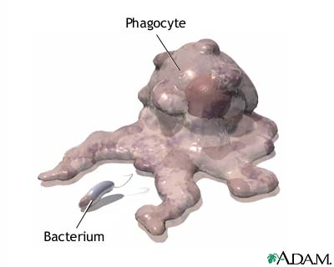
IV. TYPES OF ACTIVE TRANSPORT
a. Phagocytosis: the engulfing of large, solid particles resulting in the production of a vacuole (vesicle).

Slide 5
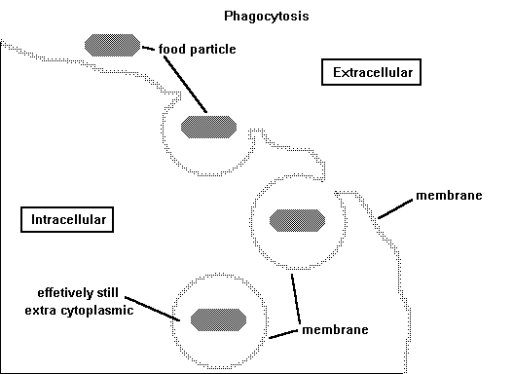
b. Pinocytosis: the invagination of a cell to facilitate the absorption of liquids. This process also results in the production of a vacuole (vesicle).

Slide 6
IV. SOLUTIONS
solutions: homogeneous mixtures that consist of a solute and a solvent.
solute: the material that is dissolved within the solution. Usually, the solute is found in lesser quantity in the solution.
solvent: the material that dissolves the solute. Usually, the solvent is found in greater quantity than the solute.

Slide 7
a. TYPES OF SOLUTIONS
1. Hypertonic Solutions: solutions that have a high concentration of solute as compared to other solutions.
2. Hypotonic Solutions: solutions that have a low concentration of solute as compared to other solutions.
3. Isotonic Solutions: solutions that have the same solute concentration as other solutions.

Slide 8
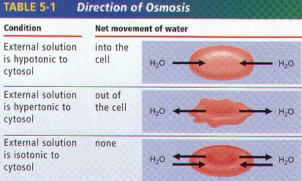

Slide 9
b. The Effects of Solutions on Cells
1. If the cell is placed in a hypertonic solution, the cell will shrink due to the outward diffusion of water. This is called plasmolysis.
2. If the cell is placed in a hypotonic solution, the cell will burst due to the inward diffusion of water. This is called cell lysis.
3. If the cell is placed into a isotonic solution, the rate of water diffusion into the cell is equal to the rate of outward diffusion. The result is that the cell’s shape will not change.

Slide 10
CIRCULATION
Aim: How can we characterize circulation in simple and complex organisms?

Slide 11
I. Circulation: definition
the movement of materials throughout an organism.
a. Circulatory Systems:
KEY IDEA:
Simple organisms do not require a specialized circulatory system.
The cells of simple organisms are in direct contact with their external environment.
Therefore, circulation occurs via diffusion, osmosis, cyclosis, and active transport.

Slide 12
1. Circulation in Monerans, Protists, and Fungi
members of each of these kingdoms (in general) are considered to be simple.
due to their simplicity, no specialized circulatory system exists.

Slide 13
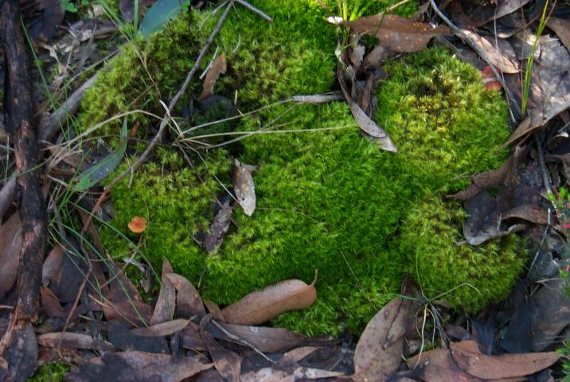
2. Circulation in Plants
bryophytes (moss, liverworts) – lack vascular tissue. No specialized system of circulation.

Slide 14
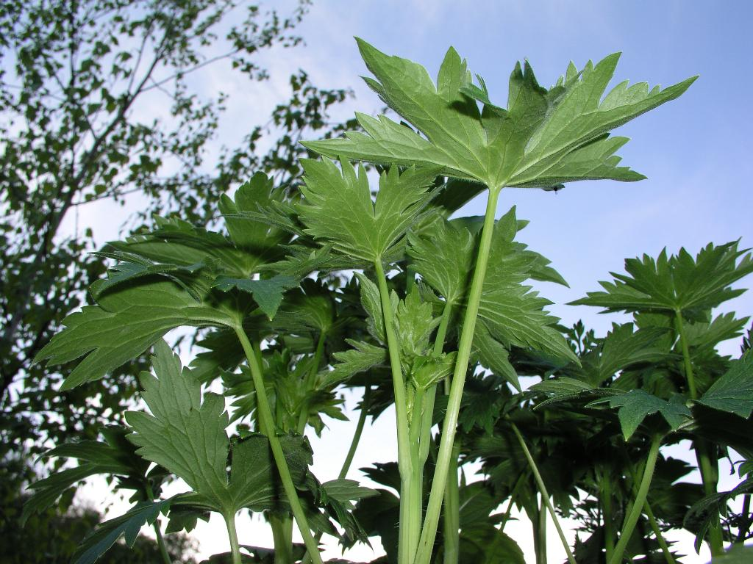
tracheophytes – contain vascular tissue (phloem and xylem); specialized circulation occurs via evapotranspiration.

Slide 15
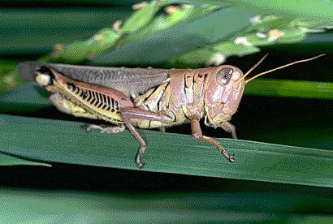
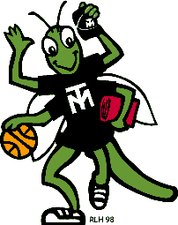
3. Circulation in Animals (invertebrates)
Open Circulatory System: (Mollusks, Arthropods)
blood bathes internal organs directly.
no distinction between blood and the interstitial fluid.
the heart pumps the blood directly throughout the body accumulating in large, open sinuses.
body movement helps return the blood to the heart.

Slide 16
Circulation in Animals (vertebrates)
have closed circulatory systems.
circulatory system consists of blood, blood vessels, and a heart.
all of the blood is contained within the blood vessels at all times.

Slide 17
II. The Circulatory System of Complex Animals
a. Characteristics
closed circulatory systems (cardiovascular system).
consists of a heart, blood vessels and blood.
delivers nutrients, oxygen, water, and salts to cells.
delivers metabolic wastes away from cells.

Slide 18
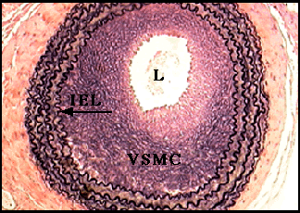
b. Components: Circulatory System
Blood Vessels:
transport tubes that carries blood throughout the body.
a. Arteries:
muscular, thick-walled, highly elastic.
carries blood away from the heart.
very high blood pressure in the arteries.

Slide 19
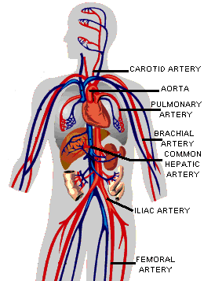
Arteries in the Human Body

Slide 20
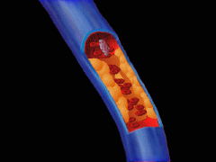
b) Veins
are blood vessels that transport blood back to the heart from the body.
are smaller in diameter and less elastic as compared to arteries.
Veins have small valves that prevent blood from flowing backwards.

Slide 21
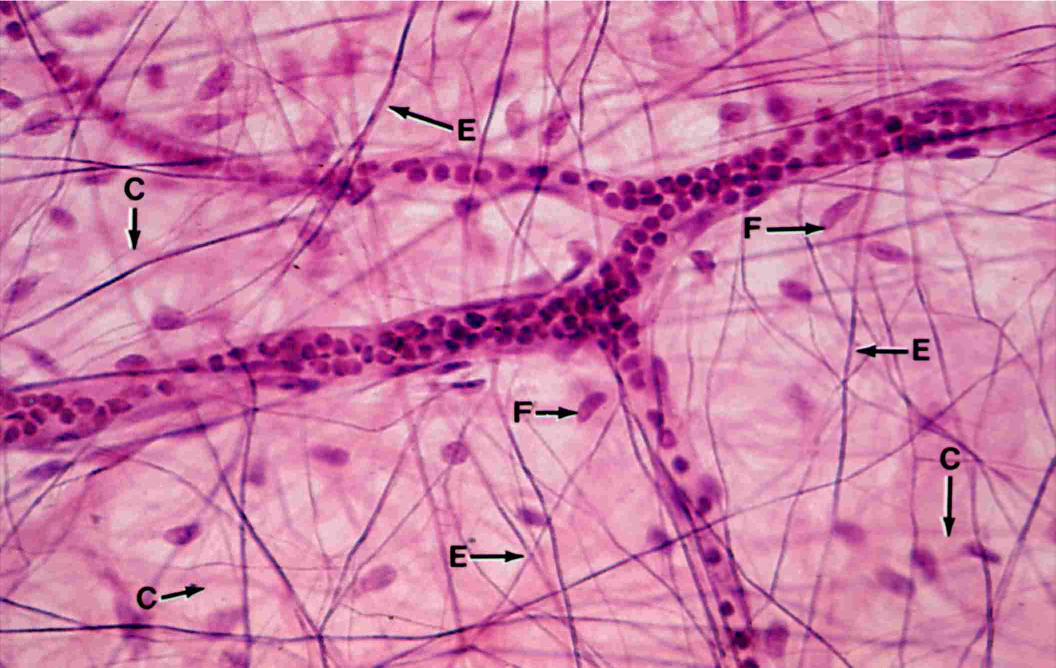
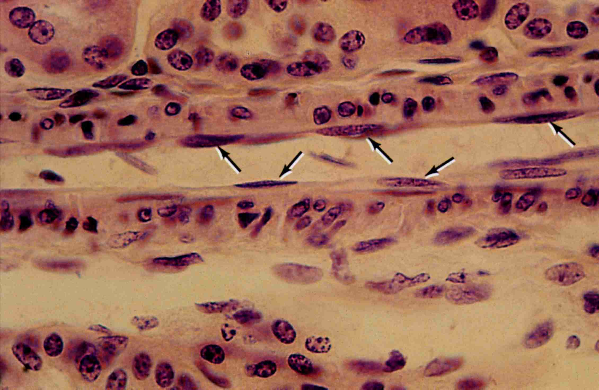
c) Capillaries
smallest and most numerous of the blood vessels.
The diameter of capillaries is one-cell thick.
Nutrients, water, minerals, wastes, oxygen, and carbon dioxide diffuse from the blood in the capillaries to the cells of the body.
Capillaries connect arteries to veins.
From: http://classes.aces.uiuc.edu/AnSci312/Capilary/Angilect.htm

Slide 22
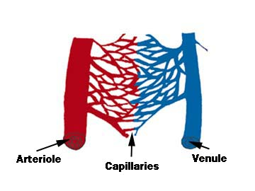
Blood flow from the heart.
Blood flow towards the heart.

Slide 23
2. Blood: The blood of mammalian consists of a liquid (plasma) and a number of cellular and cell fragment components.
PLASMA
Plasma is the liquid component of the blood.
Plasma has 90% water and 10% dissolved materials including proteins, glucose, ions, hormones, and gases.
It acts as a buffer, maintaining pH near 7.4.
Buffers are chemicals that prevent a change in the pH (acidity and basicity) of a solution.
White blood cells, also known as leukocytes, are larger than erythrocytes, have a nucleus, and lack hemoglobin. They function in the cellular immune response. White blood cells (leukocytes) are less than 1% of the blood's volume. They are made from stem cells in bone marrow. There are five types of leukocytes, important components of the immune system. Neutrophils enter the tissue fluid by squeezing through capillary walls and phagocytozing foreign substances. Macrophages release white blood cell growth factors, causing a population increase for white blood cells. Lymphocytes fight infection. T-cells attack cells containing viruses. B-cells produce antibodies. Antigen-antibody complexes are phagocytized by a macrophage. White blood cells can squeeze through pores in the capillaries and fight infectious diseases in interstitial areas
Platelets result from cell fragmentation and are involved with clotting. Platelets are cell fragments that bud off megakaryocytes in bone marrow. They carry chemicals essential to blood clotting. Platelets survive for 10 days before being removed by the liver and spleen. There are 150,000 to 300,000 platelets in each milliliter of blood. Platelets stick and adhere to tears in blood vessels; they also release clotting factors. A hemophiliac's blood cannot clot. Providing correct proteins (clotting factors) has been a common method of treating hemophiliacs. It has also led to HIV transmission due to the use of transfusions and use of contaminated blood products.

Slide 24
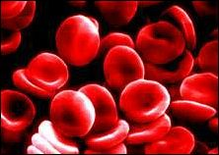
RED BLOOD CELLS
Red blood cells are flattened cells that contains the protein, hemoglobin.
Hemoglobin carries oxygen from the blood to the cells of the body. associated in the cell's
Red blood cells are continuously manufactured in red marrow of long bones, ribs, skull, and vertebrae.
Life-span of an erythrocyte is only 120 days, after which they are destroyed in liver and spleen.
Iron from hemoglobin is recovered and reused by red marrow.

Slide 25
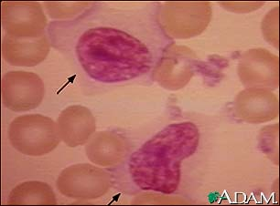
WHITE BLOOD CELLS
White blood cells help in fighting off pathogens (bacteria, viruses).
They function in the immune system.
They are made from cells in bone marrow (the center of long bones).
White blood cells produce antibodies which deactivate the pathogens that cause infection and disease.
B-cells and T-cells are examples of WBC.
WBC
RBC

Slide 26
PLATELETS
Platelets are involved in the process of blood clotting.
Platelets are cell fragments that are produced in bone marrow.
Platelets stick and adhere to tears in blood vessels; they also release clotting factors.
A hemophiliac's blood cannot clot.
Providing correct proteins (clotting factors) has been a common method of treating hemophiliacs.
It has also led to HIV transmission due to the use of transfusions and use of contaminated blood products.

Slide 27
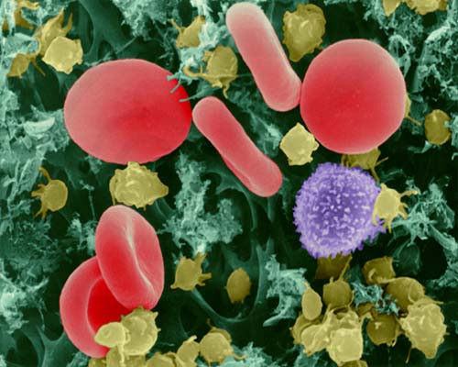
This image is copyright Dennis Kunkel at www.DennisKunkel.com, used with permission.
RBC
PLATELETE
WBC

Slide 28
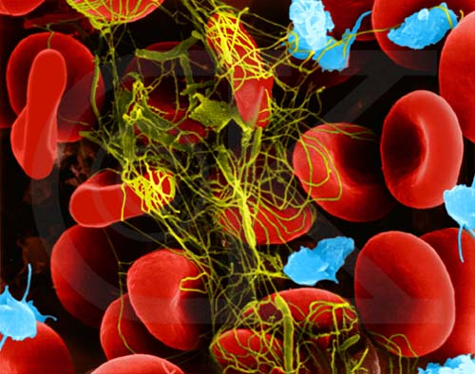
Blood Clot Formation (blood cells, platelets, fibrin clot) (SEM x10,980). This image is copyright Dennis Kunkel at www.DennisKunkel.com, used with permission.

Slide 29
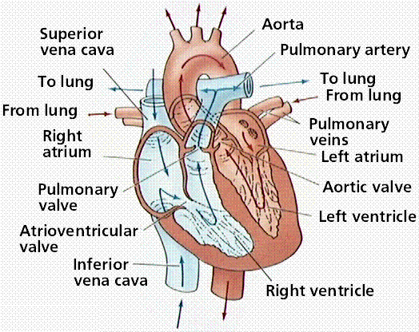
3. The Heart
The Heart is a muscular structure that contracts in a rhythmic pattern to pump blood.
The human heart is a two-sided, 4 chambered structure with muscular walls.

Slide 30
Location: The heart is located roughly in the center of the chest cavity. It is covered by a protective membrane, the pericardium.
Blood Flow Through the Heart
The vena cava (vein) returns deoxygenated blood from the body to the right atrium of the heart.
It flows into the right ventricle..
Contraction of the ventricle forces the blood into the pulmonary artery.
The blood is then carried to the right and left lungs.
The blood gives up carbon dioxide and takes on a fresh supply of oxygen.
From the lungs, the oxygenated blood returns to the heart through the pulmonary veins.

Slide 31
The pulmonary veins carry oxygenated blood to the left atrium of the heart.
From the left atrium, blood flows into the left ventricle.
Contraction of the left ventricle supplies blood to the aorta.
Blood from the aorta (artery) passes into a branching system of arteries that lead to all parts of the body.

Slide 32
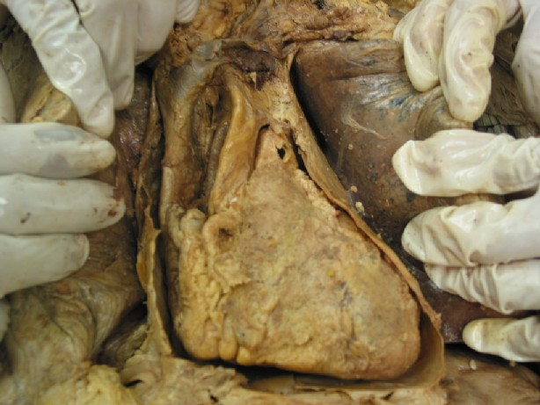
THE HUMAN HEART

Slide 33
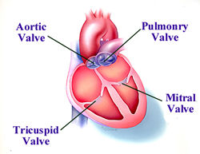
The Valves of the Heart prevents the backflow of blood into the chambers.
Tricuspid and Mitral (Bicuspid) Valves are also know as atrioventricular valves.
Aortic and Pulmonary Valves are also know as semilunar valves.

Slide 34
c) The Heartbeat
During rest, the heart beats about 70 times a minute in the adult male, while pumping about 5 liters of blood.
The stimulus that maintains this rhythm is self-contained.
Embedded in the wall of the right atrium is a mass of specialized heart tissue called the sino-atrial (S-A) node.
The S-A node is also called the pacemaker because it establishes the basic frequency at which the heart beats.

Slide 35
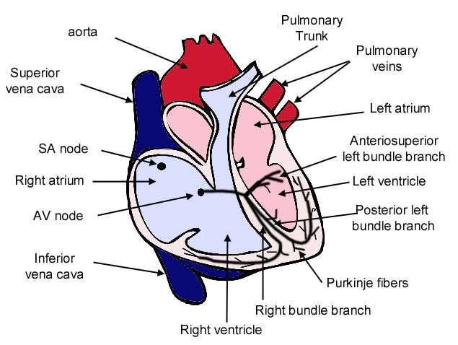

Slide 36
When this current reaches the region of insulating connective tissue between the atria and the ventricles (Bundle of His), it is picked up by the A-V node (atrio-ventricular node).
This leads to a system of branching fibers (Purkinjie Fibers) that carries the current to all parts of the ventricles.
The contraction of the heart in response to this electrical activity creates systole.
A period of recovery follows called diastole.
The heart muscle and S-A node become recharged.
The heart muscle relaxes.
The atria refill.

Slide 37
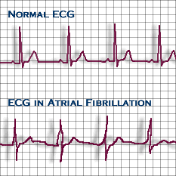
d) The Electrocardiogram (EKG)
The electrical activity of the heart can be detected by electrodes placed at the surface of the body. By analyzing the electrocardiogram (ECG or EKG), health care professionals can aids in determe the extent of damage following a heart attack.

Slide 38
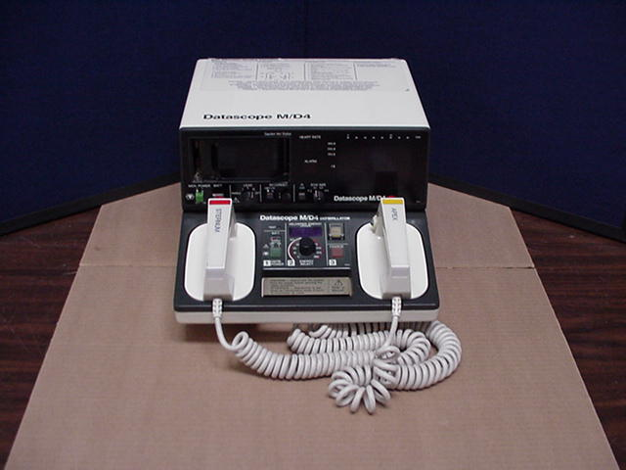
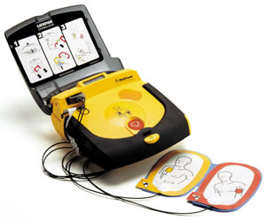
e) Ventricular Fibrillation
When the impulses arising in the ventricles become disorganized and random resulting in a spasmodic twitch.
This is called ventricular fibrillation. Blood flow ceases and unless the heart rhythm is restarted, death follows swiftly. Defibrillators may restore its natural rhythm and save the victim's life.

Slide 39
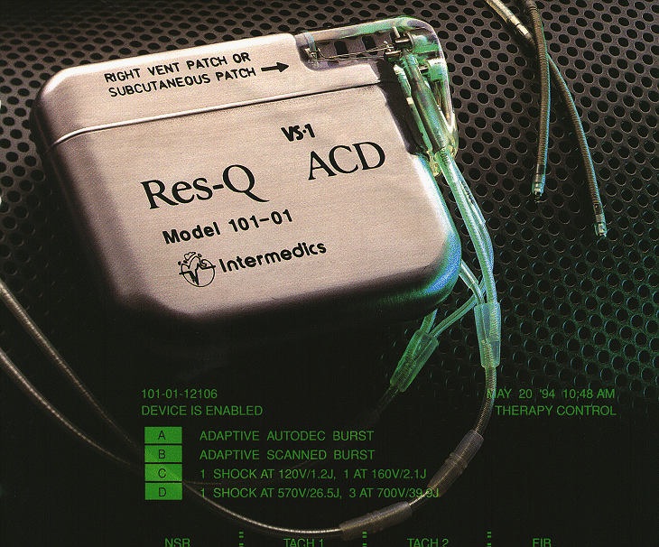
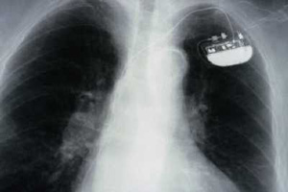
f) Artificial Pacemakers
These are devices that generate rhythmic impulses that are transmitted to the heart by fine wires.

